Slide 1
Ensemble Learning Dr. Farhan hassan khan
MACHINE LEARNING

Slide 2
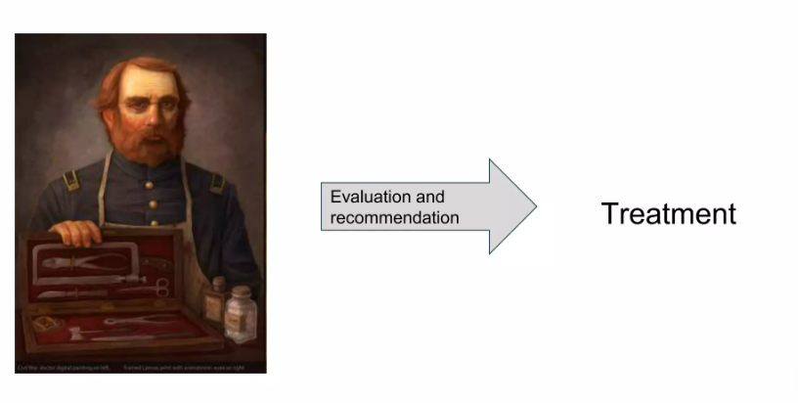
Scenario: One recommendation

Slide 3

Scenario: Many recommendations

Slide 4
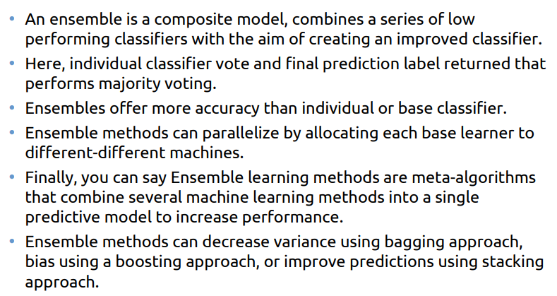
Ensemble Learning

Slide 5
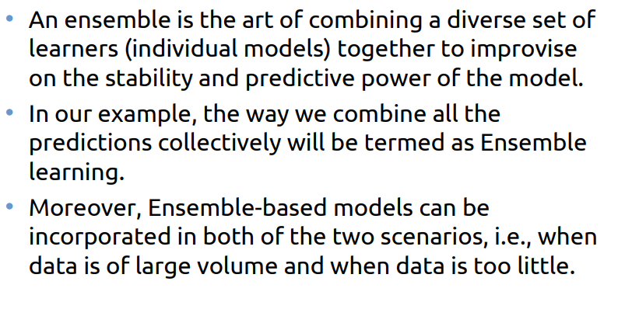
Ensemble learning

Slide 6
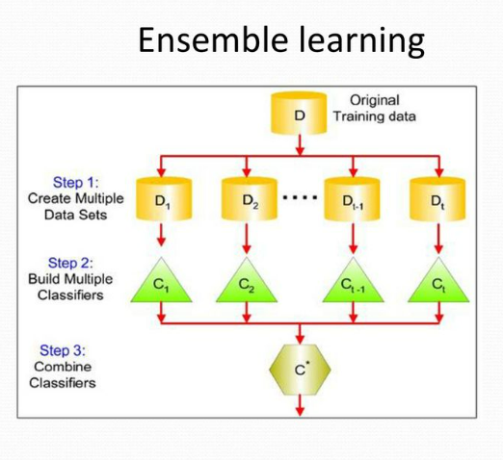
Ensemble learning

Slide 7
Types of Ensembles
Homogeneous Ensembles
Heterogeneous Ensembles

Slide 8
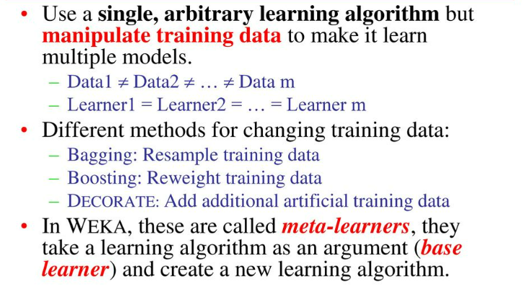
Homogeneous Ensembles

Slide 9
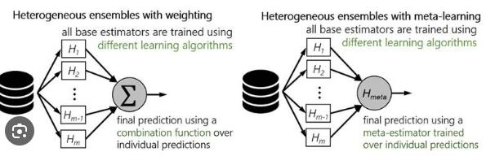
Heterogeneous Ensembles

Slide 10
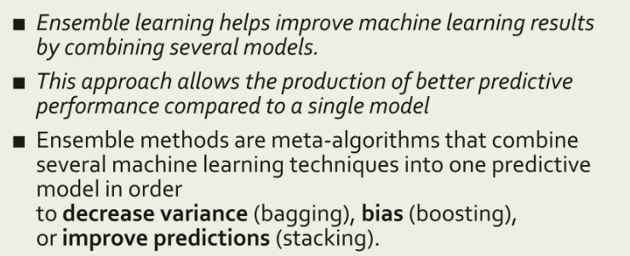
Why do we use Ensembles?

Slide 11
Ensemble methods
Parallel Ensemble Methods
Sequential Ensemble Methods
Stacking

Slide 12
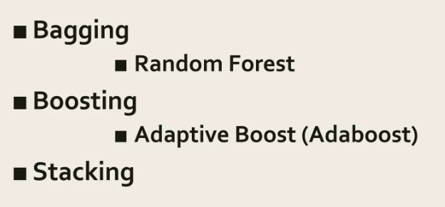
Methods

Slide 13
Parallel ensemble method
In the Parallel ensemble method, the base learners or the algorithm are generated in parallel.
Several estimators or models are built independently and then average their predictions.
On average, the combined estimator is usually better than any of the single base estimators because its variance is reduced.
The variance of the combined predictions is reduced to 1/n (n is the number of models or samples).

Slide 14
Parallel ensemble methods
Bootstrap Aggregating (Bagging)
Random Forest (Bagging)

Slide 15
Sequential ensemble method
In the sequential ensemble method, the base learners are generated sequentially.
The overall performance can be boosted by weighing previously mislabeled examples with higher weight.
Overall it reduces the bias of the combined estimator.
In simple words, boosting refers to a family of algorithms that can convert weak learners to strong learners.
The main principle of boosting is to fit a sequence of weak learners/ models that perform better in different versions of the data.
More weight is given to examples that were misclassified by earlier rounds.

Slide 16
Sequential ensemble method
Gradient Boosted Decision Trees (GBDT)
XG Boost
Ada Boost
Light GBM
Cat Boost

Slide 17
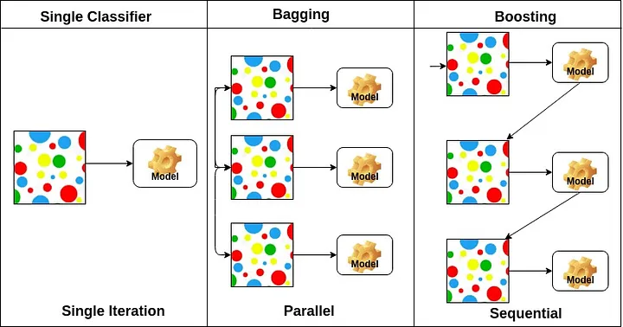
Parallel vs sequential ensemble methods

Slide 18
Parallel Ensemble methods

Slide 19
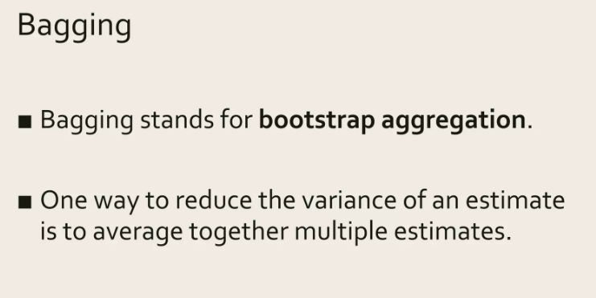
Parallel ensemble methods Bagging

Slide 20
Parallel ensemble methods bagging
In this method, models are generated using the same algorithm with random sub-samples of the dataset with the bootstrap sampling method to reduce the variance.
In bootstrap sampling, some original examples appear more than once and some original examples are not present in the sample.
The bagging technique is useful for both regression and classification.
In regression, it takes the mean of all models and in classification, it considers votes of each model.

Slide 21
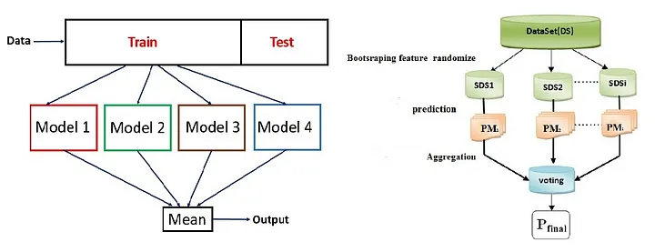
Parallel ensemble methods bagging

Slide 22
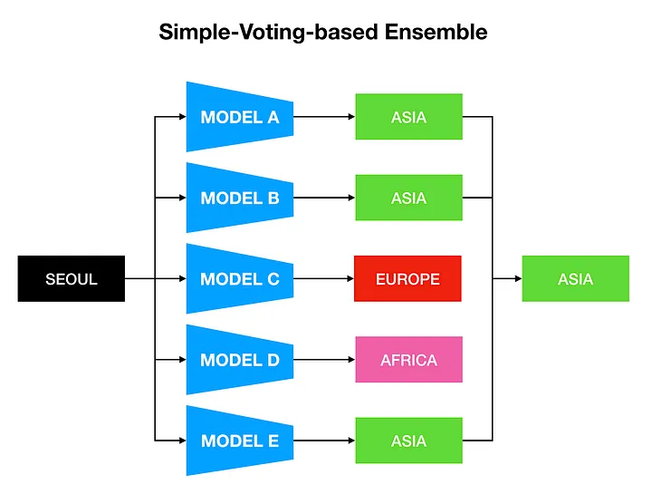
Parallel ensemble methods bagging

Slide 23
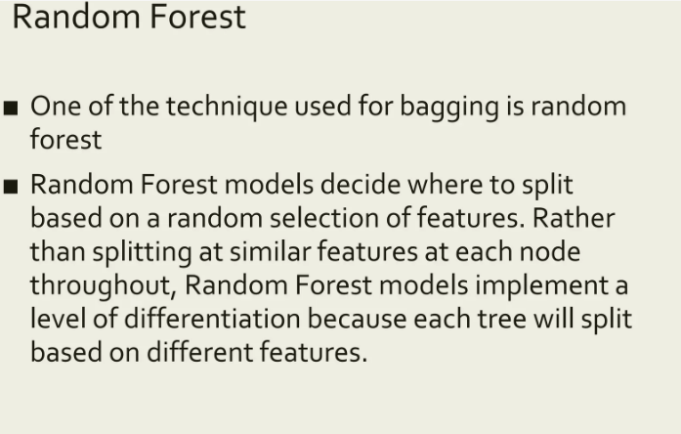
Parallel ensemble methods Random Forest

Slide 24
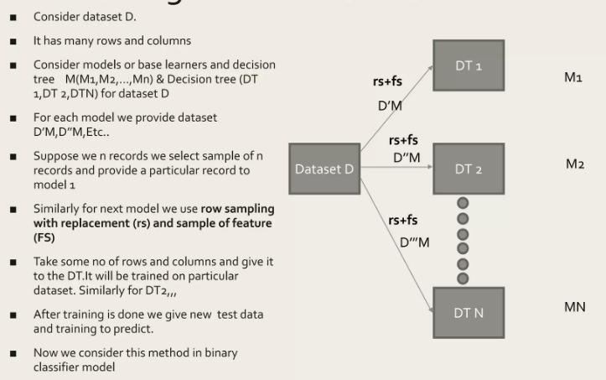
Working with Random Forest

Slide 25
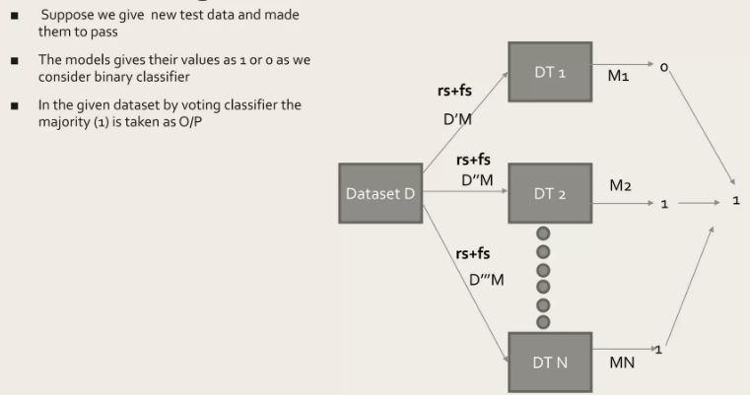
Testing with Random Forest

Slide 26
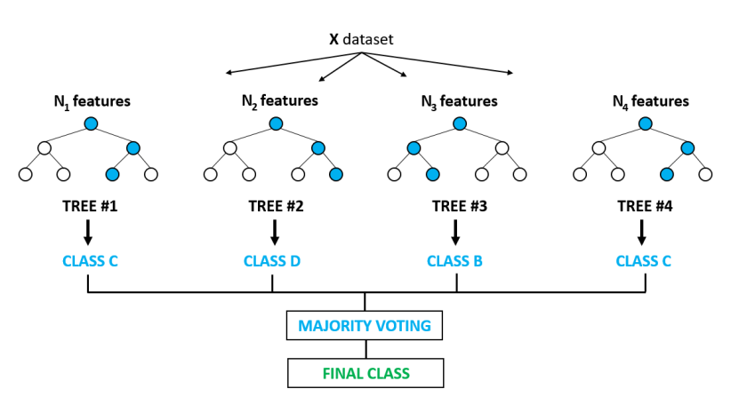
Majority Voting in Random Forest

Slide 27
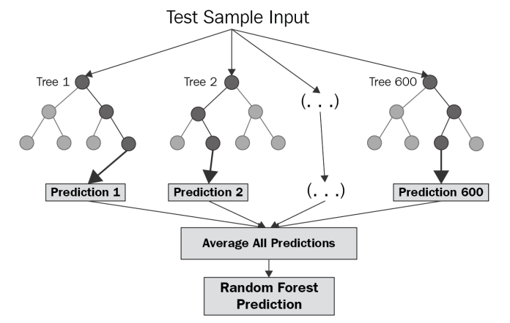
Regressor output

Slide 28
Sequential Ensemble methods

Slide 29
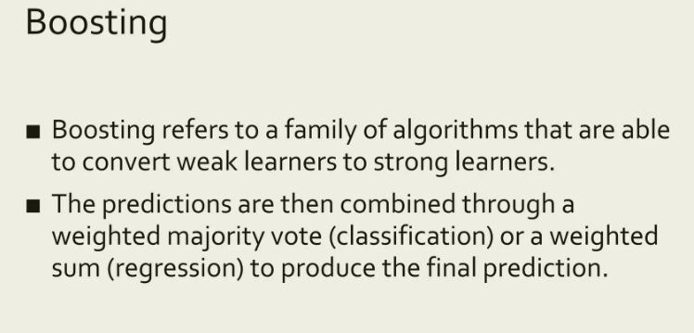
Boosting

Slide 30
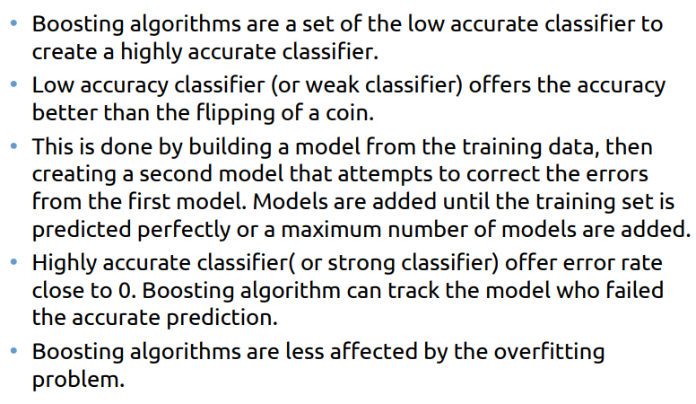
Boosting

Slide 31
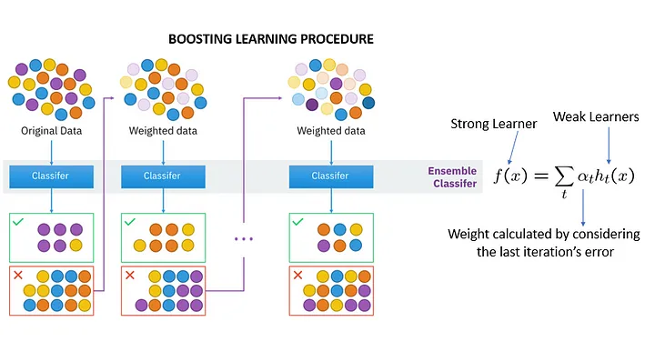
boosting

Slide 32
Gradient Boosted Decision Trees (GBDT)
Uses Gradient Descent Algorithm on Decision trees to reduce loss at each level.
It generalizes models by allowing optimization of an arbitrary differentiable loss function.
The next model is built on the errors of the previous model.

Slide 33
XG Boost
XG Boost works similar to GBDT, but it has some more features (below) which makes it more efficient.
Regularization: Standard GBM implementation has no regularization like XGBoost, therefore it also helps to reduce overfitting. In fact, XGBoost is also known as the ‘regularized boosting‘ technique.
Parallel Processing: XGBoost implements parallel processing at root nodes and becomes faster as compared to GBM.
High Flexibility: XGB allows for custom evaluation criteria.
Handling Missing Values: Can handle missing values on its own.
Tree Pruning: XGB does tree pruning on its own and reduces variance.
Built-in Cross-Validation: XGBoost allows the user to run cross-validation at each iteration of the boosting process.
Continue on Existing Model: User can start training an XGBoost model from its last iteration of the previous run.

Slide 34
Ada Boost
Here, usually, each weak learner is developed as decision stumps that are used to classify the observations
A stump is a tree with just a single split and two terminal nodes.
After each classifier is trained, the classifier’s weight is calculated based on its accuracy.
More weight is assigned to the classifier when accuracy is more and vice-versa.

Slide 35
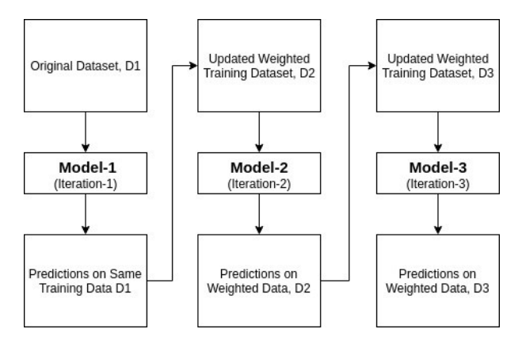
Adaboost working

Slide 36
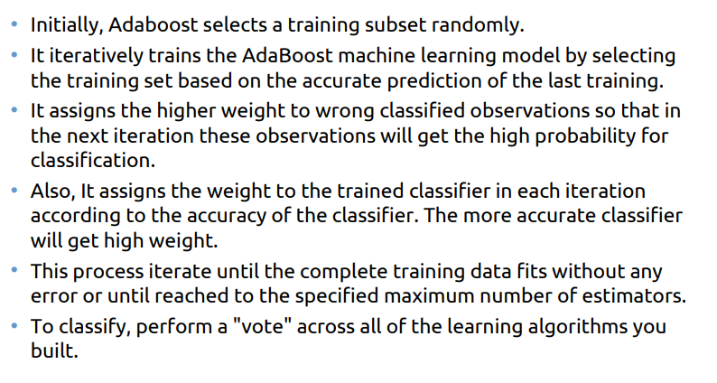
Ada boost

Slide 37
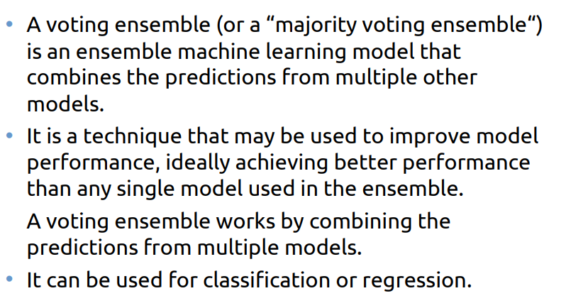
Voting

Slide 38
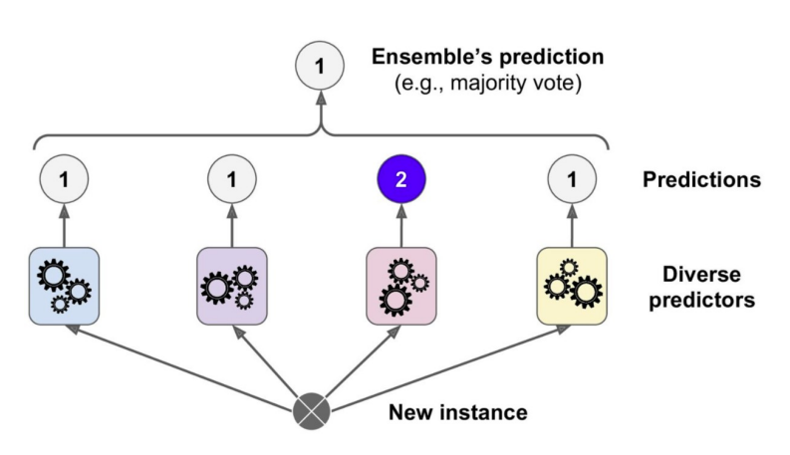
Voting

Slide 39
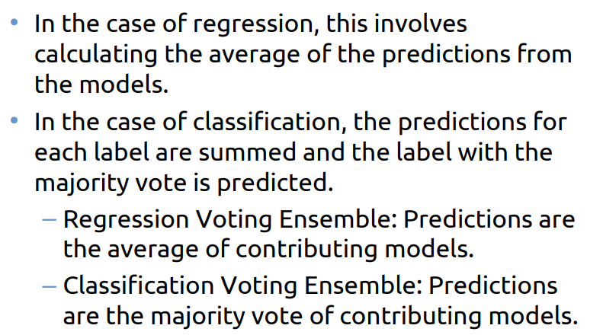
Voting

Slide 40
Stacking

Slide 41
Stacking
Stacking is an ensemble learning technique that combines multiple classifications or regression models via a meta-classifier or a meta-regressor.
The base-level models are trained based on a complete training set, then the meta-model is trained on the outputs of the base level model as features.

Slide 42
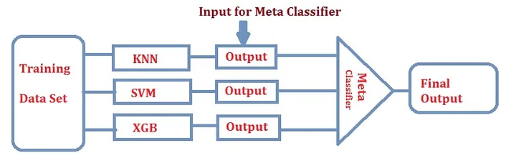
Stacking

Slide 43
Stacking
The meta model uses the base model predictions as features to learn how to optimally combine them.
Techniques for aggregation include simple averaging, weighted averaging, or even training another machine learning model ranging from a simple linear regression to a neural network.

Slide 44
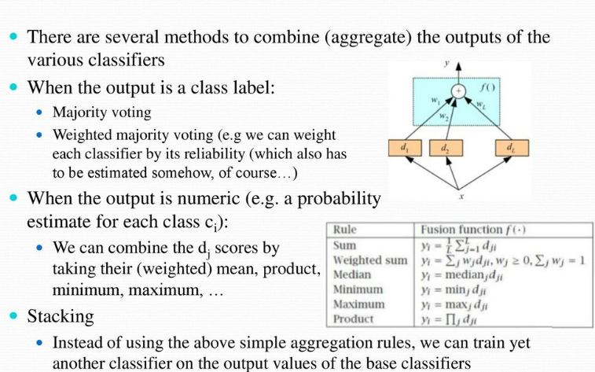
Aggregation Methods

Slide 45
End of lecture

